Slide 1
AI-ML Solution Building Campus Solutions TEAM 02 THEME – PCP Management System
Utkarsh Dev
Sept 2020

Slide 2




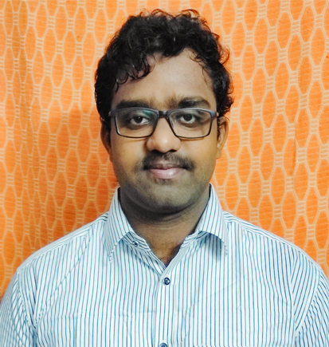
The Team
Utkarsh Dev
Goa Institute of Management
Vignesh Thakkar
IIM Kashipur
Vishal Kumar
RNS Institute of Technology
Naga Bhaskar Alaparthi
SRKR Engineering College

Slide 3



The Problem Statement
John | Glenn | Tracy
John has an insurance plan with one of the leading health insurance firms in America. He suffers from spondylosis and currently has back pain, neck pain and dizziness. He feels he needs to visit a doctor, but doesn’t have a PCP. He needs suggestion for best doctors near him. | Glenn has recently moved to his new house. Address change with the health insurance company has not been a pleasant experience for her. | Tracy has been dissatisfied with her PCP recently. She consulted her friends about a good doctor near her area. She is unable to decide.
Can we help find a suitable doctor for him, given his health conditions? | Can we automate the entire process of address change with the health insurance company and find a suitable PCP in and around her new neighbourhood? | Given her medical history, can we help her find a good PCP in the neighbourhood?

Slide 4
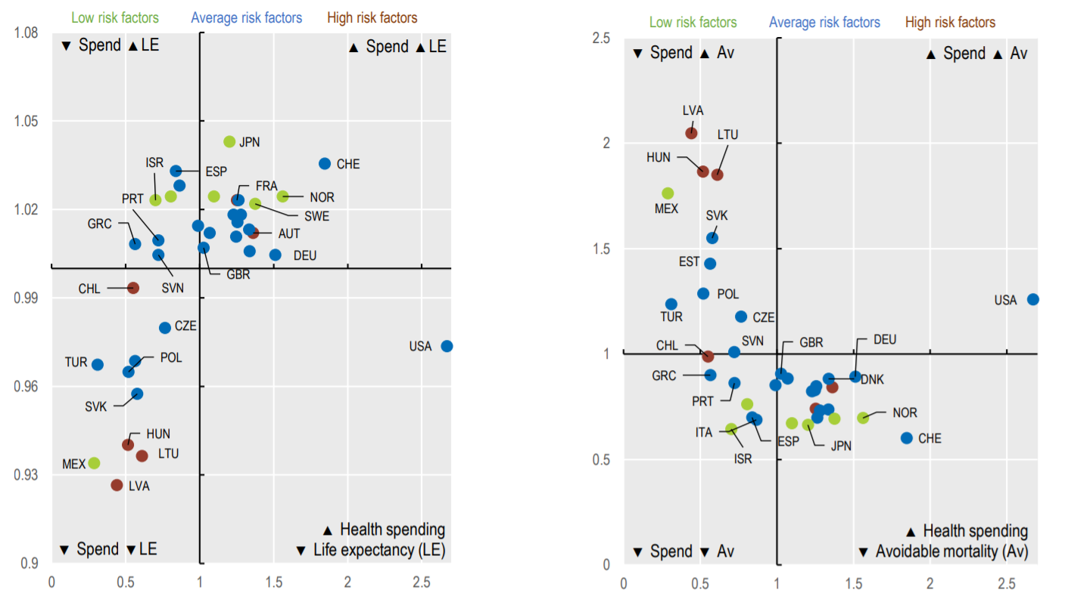
Insights – The US Healthcare Industry
In 2017, Over 45% of all deaths in US is caused by Heart Disease, Cancer … | … Diabetes, lead cause of heart diseases and cancer, is on the rise, and often goes undiagnosed …
… Obesity, one of the leading cause of diabetes, has shown an uptick among children and adults | In contrast to other countries, US has low life expectancy and higher avoidable mortality, despite high healthcare spending
Leading Causes of death among males and females, 2017
Health Spending vs. Life Expectancy
Health Spending vs. Avoidable Mortality
LE
Av
Spend
Spend
Source : Health, US 2018, National Centre for Health Statistics, Centre for Disease Control and Prevention

Slide 5
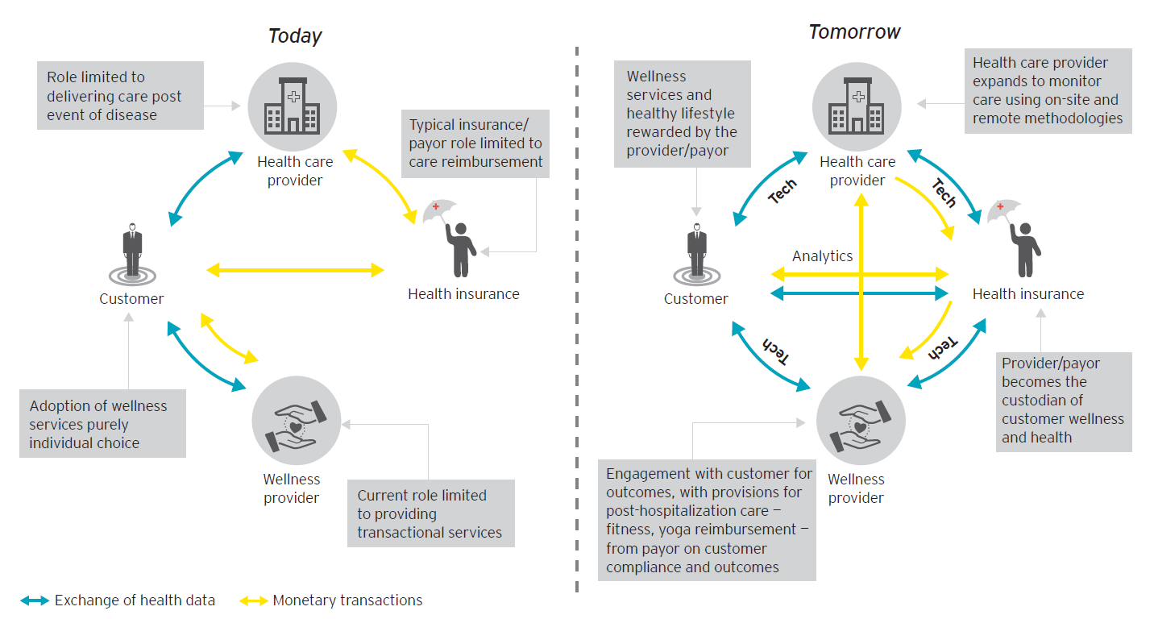
Insights – The US Health Insurance Industry
The industry is mostly dominated by private health insurance companies … | … although coverage and insurance type vary across age groups, race and ethnicity
The future of health insurance industry lies in continuous innovation and leveraging technology … | … to address customer pain points
Customer Needs | Solutions
Personalized healthcare experience | Become truly customer centric Enhance customer engagement and customer experience
Economically rational coverage and care choices | Enhance transparency Steer members into making a well informed decisions by showing how costs add-up over time
Overwhelmed by too many options | Simplify Understand clients to personalized PCP and healthcare plan recommendations
Source : Enabling Healthcare Consumerism, McKinsey & Co.
What matters the most to healthcare consumers, Deloitte

Slide 6
Customer Segmentation
 | Casual & Cautious | Content & Compliant | Online & Onboard | Sick & Savvy | Out & About | Shop & Save
%age of population | 34% (112 Mn) | 22% (73 Mn) | 17% (56 Mn) | 14% (46 Mn) | 9% (30 Mn) | 4% (13 Mn)
Demographic Profile | 30% Millennials Average age = 41 years 51% Male, 49% Female Well educated, racially and ethnically diverse | 23% Seniors Average age = 52 years 53% Male, 47% Female less educated, less racially and ethnically diverse | Millennials, Gen-X and Boomers Average age = 44 years 44% Male, 56% Female Well educated, racially and ethnically diverse | Boomers and Seniors Average age = 54 years 41% Male, 59% Female Well educated, less racially and ethnically diverse | Millennials, Gen-X and Boomers Average age = 45 years 37% Male, 63% Female Well educated, racially and ethnically diverse | 36% Millennials Average age = 39 years 56% Male, 44% Female Well educated, racially and ethnically diverse
Economic Profile and Financial Preparedness | Low Income 59% earn < $50K Least likely to have insurance Only 8% feel financially ready for future medical expenses | 47% earn < $50K, 17% earn > $100K 87% have health insurance Feel most financially ready for future medical expenses | High income 25% earn > $100K 87% have health insurance 22% feel financially ready for future medical expenses | High income 23% earn > $100K 92% have health insurance 23% feel financially ready for future medical expenses | Low Income 58% earn < $50K 76% have health insurance 9% feel financially ready for future medical expenses | High Income 24% earn > $100K 93% have health insurance 22% feel financially ready for future medical expenses
Use of healthcare technology | Lowest Least interest in comparing healthcare plans, providers 29% have privacy concerns | Low Less interest in comparing healthcare plans, providers 38% have privacy concerns | Highest Interested in comparing healthcare plans, providers But 38% have privacy concerns | High Interested in comparing healthcare plans, providers 36% have privacy concerns | High Interested in comparing healthcare plans, providers 37% have privacy concerns | Average Open to comparing healthcare plans, providers 36% have privacy concerns
Health Status and beliefs | Lowest rate of prevention 51% have excellent health 29% have 1 or more chronic conditions 34% believe that lifestyle have health consequences | Above avg. rate of prevention 53% have excellent health 59% have 1 or more chronic conditions 47% believe that lifestyle have health consequences | Above avg. rate of prevention 54% have excellent health 60% have 1 or more chronic conditions 54% believe that lifestyle have health consequences | Best rate of prevention 47% have excellent health 80% have 1 or more chronic conditions 58% believe that lifestyle have health consequences | Average rate of prevention 42% have excellent health 61% have 1 or more chronic conditions 54% believe that lifestyle have health consequences | Average rate of prevention 53% have excellent health 57% have 1 or more chronic conditions 40% believe that lifestyle have health consequences
Healthcare use and satisfaction | Low use and satisfaction 61% have PCP (58% satisfied) Unfavourable views of the system | High use and satisfaction 88% have PCP (91% satisfied) Favourable views of the system | Satisfied, Open to alternatives 87% have PCP (83% satisfied) Mixed views views of the system | Engaged & Satisfied 94% have PCP (89% satisfied) Favourable views of the system | Below avg. use and satisfaction 72% have PCP (55% satisfied) Most unfavourable views of the system | Low satisfaction, open to alternatives 91% have PCP (57% satisfied) Unfavourable views of the system
Preferences | Independent & Economical 69% prefer low cost healthcare plans Prefer making treatment decisions in their own | Dependent & Economical 54% prefer low cost healthcare plans Prefer their doctor to make treatment decisions | Independent & Economical 55% prefer low cost healthcare plans Prefer making treatment decisions in their own | Independent & Economical 56% prefer low cost healthcare plans Prefer making treatment decisions in their own | Independent & Economical 66% prefer low cost healthcare plans Prefer making treatment decisions in their own | Independent & Economical 61% prefer low cost healthcare plans Prefer making treatment decisions in their own

Slide 7

Targeting – Potential Market Size Estimation
 | Recommend a PCP |  |  | Recommend a Health Insurance Plan
Online & Onboard 56 Mn | 13% does not have PCP | 7.28 Mn | 15.56 Mn | 13% do not have a health insurance plan | 7.28 Mn
 | 14.79% dissatisfied with current PCP | 8.28 Mn
Sick & Savvy 46 Mn | 6% does not have PCP | 2.76 Mn | 7.52 Mn | 8% do not have a health insurance plan | 3.68 Mn
 | 10.34% dissatisfied with current PCP | 4.76 Mn
Out & About 30 Mn | 28% does not have PCP | 8.4 Mn | 18.12 Mn | 24% do not have a health insurance plan | 7.2 Mn
 | 32.4% dissatisfied with current PCP | 9.72 Mn
Shop & Save 13 Mn | 9% does not have PCP | 1.17 Mn | 6.26 Mn | 7% do not have a health insurance plan | 0.91 Mn
 | 39.13% dissatisfied with current PCP | 5.09 Mn
 | Potential Market for PCP Recommendation System |  | 47.46 Mn | Potential Market Size for Personalized Health Insurance Recommendation | 19.07 Mn

Slide 8









The Value Proposition
Dependent | Healthcare Provider | Healthcare Payor (Healthcare Payer)
All your health records at a single place, safe and secured | Better understand about your patients for improved healthcare decisions | Enhanced customer intimacy and customer engagement
 |  | Achieve operational excellence by keeping closer tab on your cashflows
Get personalized recommendations for best healthcare providers near you | Shift focus from reactive care to preventive care
 |  | Enhanced risk assessment of existing and potential customers
Browse through our recommended list of personalized healthcare plans | Optimized use of healthcare resources
 |  | Achieve product excellence by understanding your customers to remain relevant and competitive

Slide 9
The Disease – Symptoms Dataset
This dataset maps symptoms to their diseases … | … and further maps diseases to their specialties
One symptoms can be associated with one or more specialties … | … but a combination of symptoms helps us predict the disease and specialty
Symptom_1
Disease_1
Disease_1
Specialties
Allergists
Cardiac Surgeons
Dermatologists
Endocrinologists
Gastroenterologists
Neurologists
Orthopaedic Surgeons
Physicians
Pulmonologists
Specialty_1
Symptom_2
Disease_2
Disease_2
132 Symptoms
41 Diseases
…
9 Specialties
…
…
…
Specialty_9
Symptom_132
Disease_41
Disease_41
Many-To-Many
Many-To-One
Weight Loss
High Fever
Jaundice
Physician
Yellowish Skin
Dark Urine
Sources : https://www.kaggle.com/itachi9604/disease-symptom-description-dataset?select=dataset.csv

Slide 10
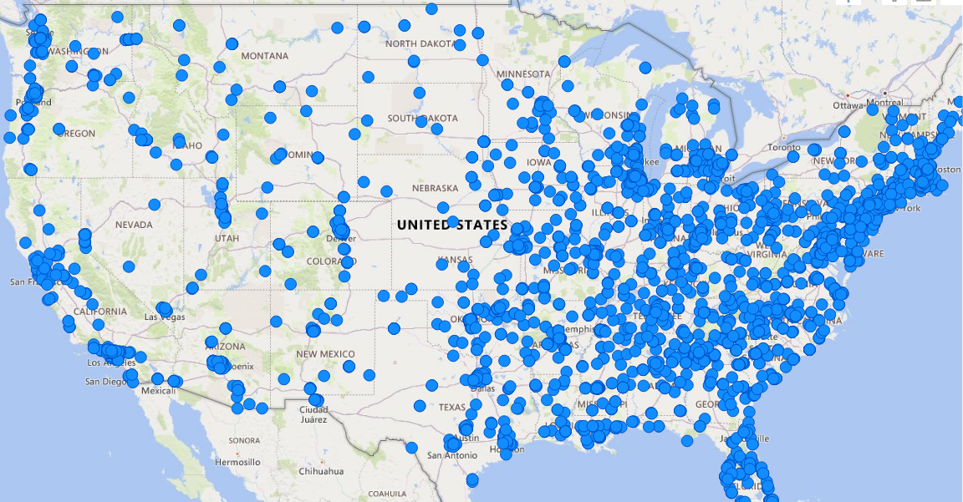
The National Provider Identifier (NPI) Dataset
The NPI dataset lists providers from all over US … | … consisting of General Physicians and 8 other specialties … |  | … but there are more males as compared to females
Ratings & Fee, although uniform across specialties, has minor differences … |  | … and we observe a similar patter when it comes to gender
Sources : Physicians and Other Supplier Data CY 2017, CMS.gov

Slide 11
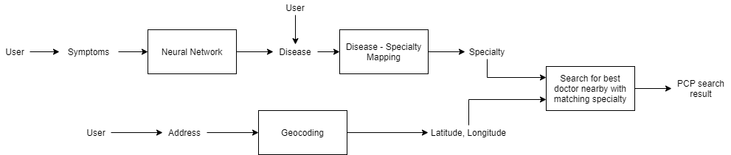
Functional Details – PCP Recommendation System
The PCP Recommendation Model
Model Training Layers – (100, 50, 25, 5) Optimizer – Adam Nestrov Momentum – 0.9 Learning Rate – Adaptive Activation – ReLu Training Dataset – 70% Validation Dataset – 10% Testing Dataset – 20% | PCPs sorting based on score Score = Distance – 2*Rating Distance Score Rating Score It makes sense to go to a doctor who is a little further if the doctor is better rated as compared to a doctor who is nearby and rated poorly | Model Comparison

Slide 12
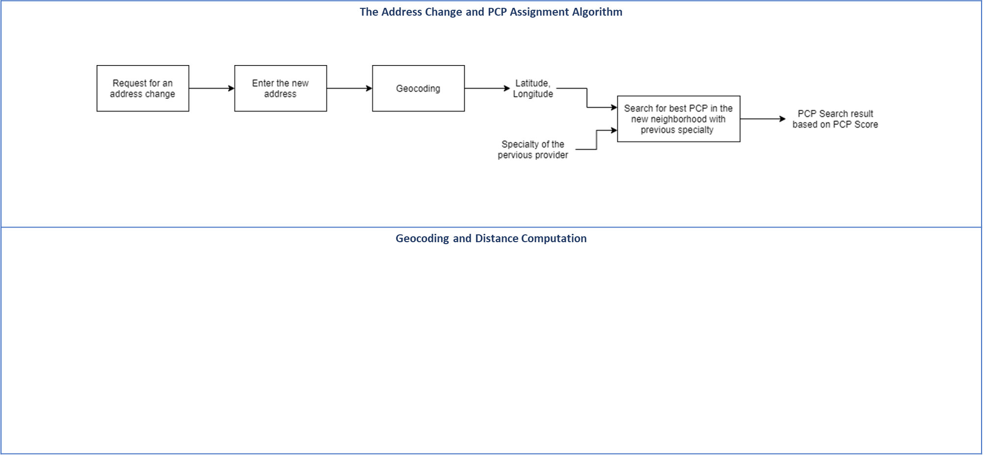

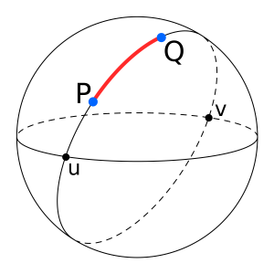
Functional Details – PCP Change based on Address
House Address | 1901 W Harrison Street
City | Chicago
State | Illinois
Latitude
Longitude
GeoPy (ArcGIS)

Slide 13
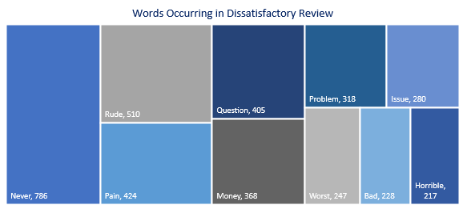
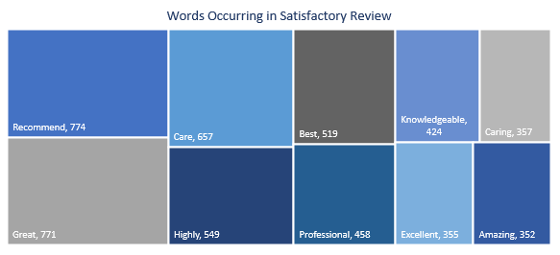
RateMD Review Dataset
Doctor reviews were collected … Source : https://github.com/avi-jit/RateMDs Scraped RateMD to collect review and ratings of doctors | … and segregated into satisfied or dissatisfied
Positive words occur frequently when the patient is satisfied … | … and negative words when the patient is dissatisfied
Staff
Average Rating >= 3
Satisfied
Ratings
Staff
Punctuality
Helpfulness
Knowledgeability
Punctuality
Reviews
Removed Punctuations
Removed Stop words
Average Ratings
Helpfulness
Average Rating < 3
Dissatisfied
Knowledgeability
Sources : Physicians and Other Supplier Data CY 2017, CMS.gov

Slide 14
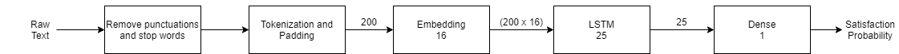
Functional Details – Dissatisfaction with the PCP
The RNN Model
LSTM vs. GRU – Training & Validation Statistics | LSTM vs. GRU – Testing Statistics
Ratings
Reviews
Satisfaction / Dissatisfaction
LSTM
Precision – 0.91
Recall – 0.90
f1 Score – 0.90
GRU
Precision – 0.90
Recall – 0.88
f1 Score – 0.89
Optimizer – Adam
Loss Function – Binary Cross-entropy
Epochs - 10
Training Dataset – 70%
Validation Dataset – 10%
Testing Dataset – 20%

Slide 15
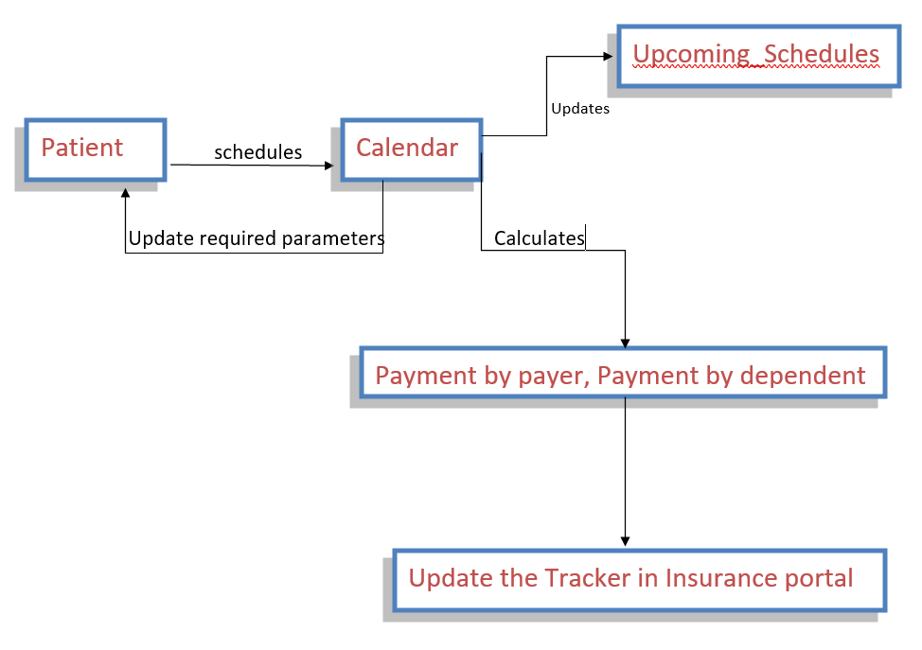
Functional Details – Real-Time Cashflow Tracker for Payor
We compute the payment by dependent and payment by payor using plan specific, dependent specific and provider specific information …
… and aggregating payment information for the next few time periods, a real-time cashflow tracker was created
Plan Specific Info
Deductible
Coinsurance
Co-payment
Out-of-Pocket Limit
Dependant Specific Info
Deductible Paid
Out-of-pocket Limit Left
Provider Specific Info
Consultation Fees
Compute Payment for Payor
and Dependant
Payment by Dependent
Payment by Payor

Slide 16
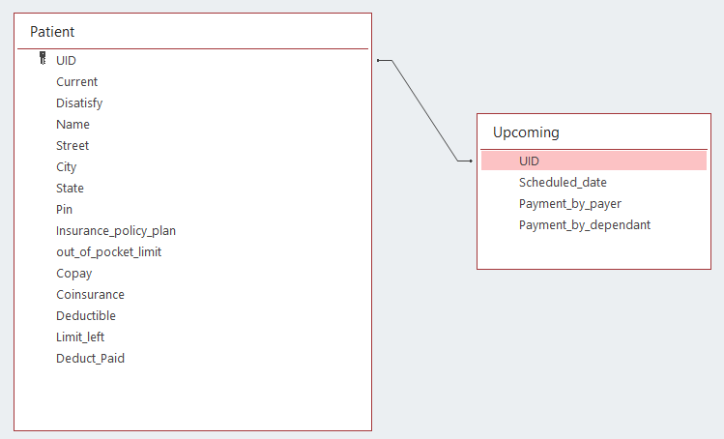
Design Details – The Database Flowchart
Assumptions
This portal is designed only for a single insurance payer
Only the members of the insurance company has access to PCP assignment
Whenever, a member signs up with the insurance firm, he is given a UID using which he can log into our portal

Slide 17









Design Details – Tools & Technologies Used
Backend | ML/DL Model Building | Frontend

Slide 18
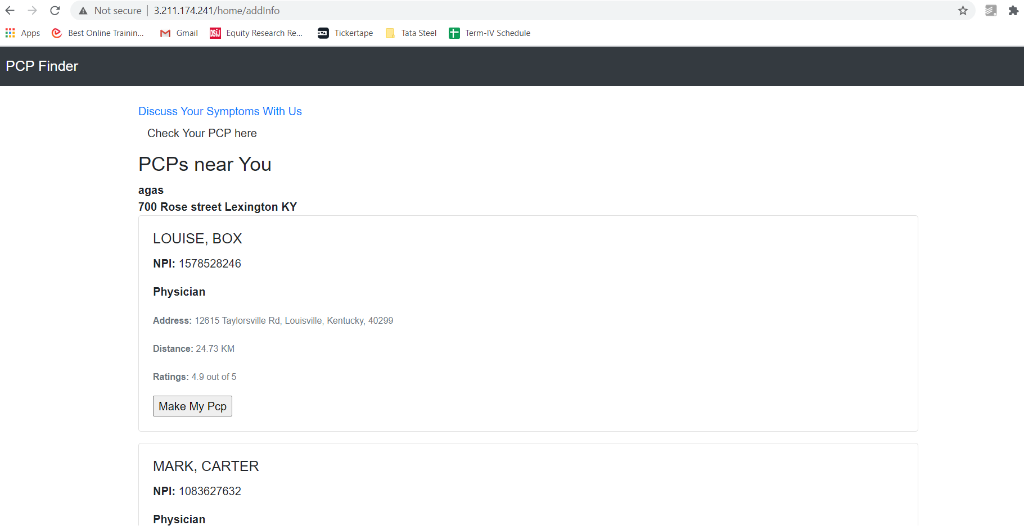
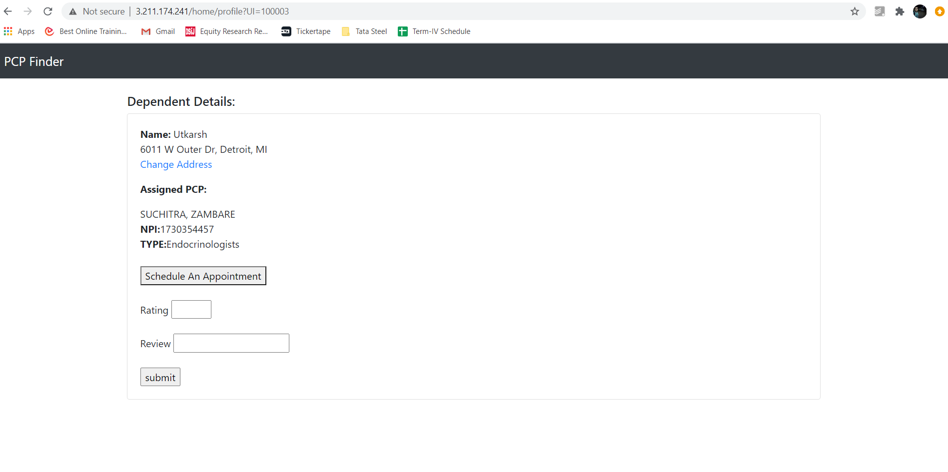
Demo Application
Find your PCP Here
The PCP Search Page
Your Profile Page

Slide 19
Conclusions & Scope
The PCP Finder we developed has the following features:
It uses state-of-the-art Deep Neural Network model which helps dependant find best PCPs near them based their medical history
It automatically suggests best PCPs near the new neighbourhood, as and when the dependant changes his/her address
It is capable to handle appointment scheduling for the dependant
It uses Recurrent Neural Network models to predict if the dependant is satisfied or dissatisfied with his/her PCP, also suggesting an option to change his/her PCP accordingly
The product analyses future appointments to estimate cashflows for the Payor based on provider Consultation Fees and the insurance plan details of the dependant
The Deep Neural Network achieves an accuracy of 98.5% and the Recurrent Neural Network achieves an accuracy of 90.68%
The future scope of the product might include:
More elaborate medical history to help the dependant find an appropriate PCP for himself/herself
Use Natural Language Processing to better understand dependant needs for improved PCP recommendation
Autodetection of location using GPS and Google Map API
Automated payment gateway for payment of premiums and consultation fees
Easy claim filing after each consultation
Schedule management system for provider

Slide 20
Thank You

